Slide 1
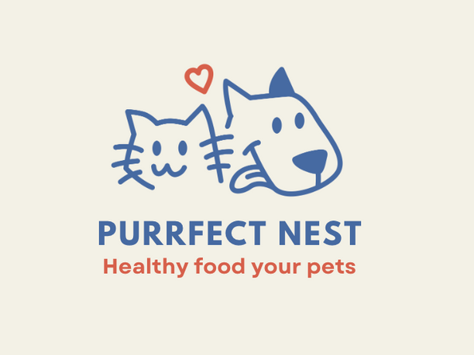





HEALTHY FOOD FOR YOUR PETS
PURRFECT NESTS
PRESENTED BY: ZAINAB ASLAM & AHMED ANSARI

Slide 2

Inventory Management System
PURRFECT NESTS
"Purrfect Nest" is an innovative standalone software tailored for the pet care industry. It integrates with existing business processes of pet stores, serving as a solution for inventory management challenges.
IDEA
"Purrfect Nest" was created to tackle inventory management challenges in pet stores, such as overstocking, understocking, product expiration, and difficulty identifying popular items. This specialized system enhances operational efficiency, improving customer experience and business profitability.
OVERVIEW

Slide 3

List of Use Cases
Inventory history tracking
Add a new pet product.
Update pet product information
Remove pet products.
Search for a pet product.
View product details.
Generate inventory reports.
Set low stock alerts.
Process customer order
Handle return and refunds
User authentication
Backup and restore data.
Customer notification.

